Slide 1

Intermediate / Advanced R topics
- The adventu{R}e begins! -
Notes:
So the class that Logan and I would LOVE to teach someday is intermediate/advanced R. Which maybe we will someday.
But actually, maybe we don’t have to, because hopefully you’ve got enough foundation now that if you want to check things out for yourselves, YOU CAN!

Slide 2
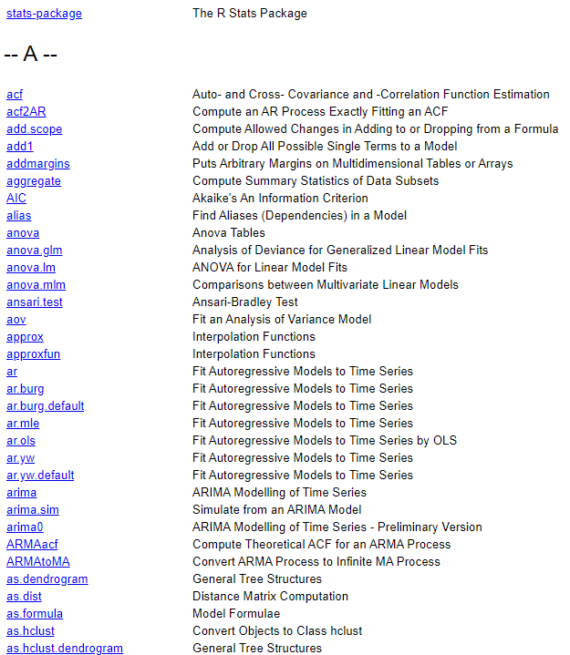
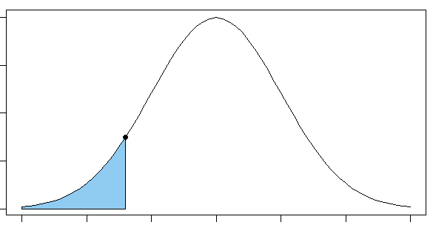
Intermediate/Advanced topics in R - see also: Things you’re now set up to explore yourself if you’d like! -
Statistics!
t.test() one- and two-sample t-tests
chisq.test() chi^2 tests
lm() linear models: simple & multiple regression
glm() generalized linear models: binomial, poisson, …
lme4::lmer() mixed-effects models
All distribution functions!
pnorm()
dnorm()
qnorm()
+ rnorm() …
Notes:
Funny that R is “statistical software” and this is the first real mention of statistics! But R has all the statistics things
This is the index for the STATS package documentation, and actually … this is just the beginning of the A’s. R has all the stats.

Slide 3
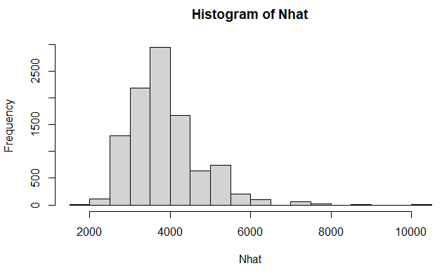
Simulation!
## EXAMPLE: Simulate results from a simple Mark-Recapture experiment…
N <- 4000 # population size
n1 <- 200 # first sample
n2 <- 350 # second sample
# randomly simulate the number of recaptures, 10000 times
m2 <- rhyper(10000, n1, N-n2, n2) # this produces a vector
# Chapman abundance estimate for each simulated replicate...
Nhat <- (n1 + 1)*(n2 + 1)/(m2 + 1) – 1
hist(Nhat) # plot a histogram
quantile(Nhat, p=c(0.1, 0.9)) # 80% interval
10% 90%
2938.625 5038.357
Notes:
R is actually great for simulation! So as a simple example, here’s simulating the results from a simple mark-recapture experiment
So here we set the population size, and the sizes of both samples
Then we can actually SIMULATE 10k replicates for the number of recaptures … this produces a vector, and we know how to math with these!!
Note that this doesn’t replace our typical sample size methods, but I would argue that it’s useful to give yourself an idea of how things might turn out!

Slide 4
Writing your own functions!
## EXAMPLE: Chapman estimator
NChapman <- function(n1, n2, m2) {
Nhat <- (n1 + 1)*(n2 + 1)/(m2 + 1) - 1
return(Nhat)
}
NChapman(n1=100, n2=200, m2=20)
[1] 965.7143
Writing your own packages??!
Just standardized bundles of functions, documentation, and maybe data
For yourself (handy because you can create good documentation)
For others (can even release to CRAN!)
Notes:
You can write your OWN functions and use them later, and here’s a simple example
It takes the sample sizes from each event and the number of recaptures as inputs (or ARGUMENTS) and returns the result!
Writing your own packages?? Yeah, you can do that too! This can be for yourself… or for others ….
I’ve actually written a few packages, and published these on CRAN, which is the

Slide 5
Loops, etc: Run a piece of code multiple times…
Load multiple files
Run the same analysis for multiple years of data
Produce a sequence of plots
Run a simulation for multiple sets of conditions
…!
Notes:
And there’s all KINDS of cool algorithmic stuff that’s possible in R:
A pretty powerful thing can be a loop…

Slide 6
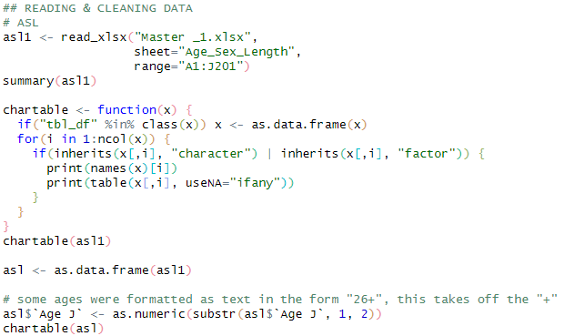
Loops + functions + … = more efficient programming!
Example: Performing the same analysis for 5 years of data
2020
2020
2020
2020
Solution 1: Five blocks of code, probably copy/pasting and changing the year when needed.
Nothing is “wrong” with this.
But:
Prone to copy-paste errors (forgetting to change the year when needed)
Future changes will need to be made five times
PAINFUL TO READ!!
20202021
20202021
20202021
20202021
20202022
20202022
20202022
20202022
20202023
20202023
20202023
20202023
20202024
20202024
20202024
20202024
Notes:
So depending on where you’re at in your R journey, maybe this isn’t useful just yet.
BUT, I really want to plant a seed for the future.
Let’s say you have a five-year project with five years of data (not so crazy, right?)

Slide 7
Loops + functions + … = more efficient programming!
Example: Performing the same analysis for 5 years of data
Solution 2: One block of code, looped over five years.
Possible benefits:
Less potential for human error
Future changes only need to be made once
More concise to write AND read
# first initialize some things
for(i in 1:5) {
[[i]]
[[i]]
[[i]]
[[i]]
}

Slide 8
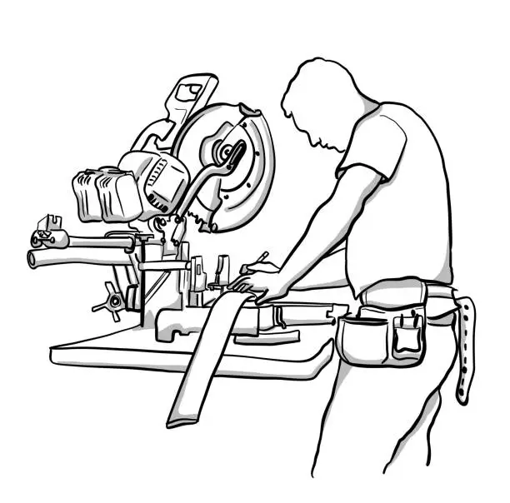

Loops + functions + … = more efficient programming!
Example: Performing the same analysis for 5 years of data
Solution 3: Generalized analysis function, run for each dataset.
Possible benefits:
Less potential for human error
Future changes only need to be made once
More concise to write AND read
Separates PURPOSE of code
Can be more flexible
E.g. adding additional arguments associated with each year?
Generalized functions can be easily re-used!
AnalysisFunc <- function(TheData) {
AnalysisFunc <- function(TheData,
AddlArgs) {
TheData
TheData
AddlArgs
TheData
TheData
}
AnalysisFunc(data2020)
AnalysisFunc(data2021)
AnalysisFunc(data2022)
AnalysisFunc(data2023)
AnalysisFunc(data2024)
AnalysisFunc(data2020, args2020)
AnalysisFunc(data2021, args2021)
AnalysisFunc(data2022, args2022)
AnalysisFunc(data2023, args2023)
AnalysisFunc(data2024, args2024)

Slide 9
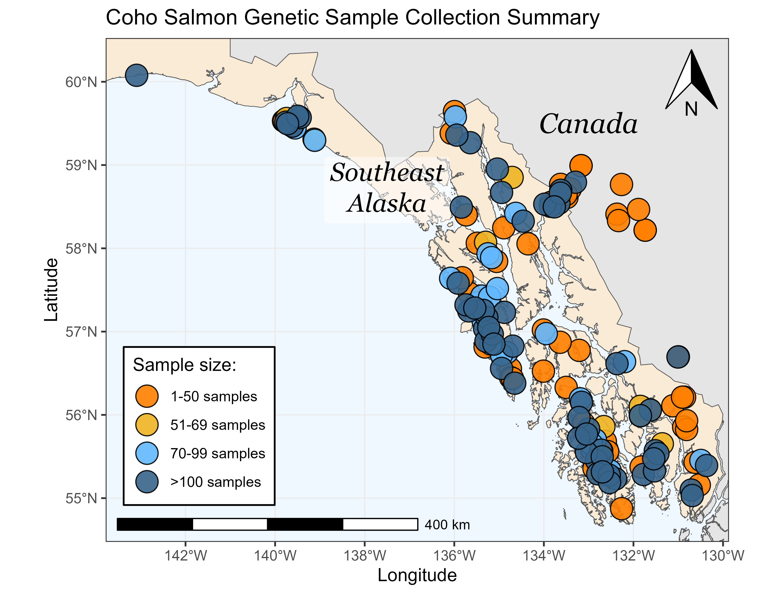
Mapping with sf, leaflet, …
Yes, you can GIS with R!
Notes:
And yes, you can GIS with R! Check out this figure that Justin made (and I stole, cuz I thought it looked cool!) This was all done in R.

Slide 10
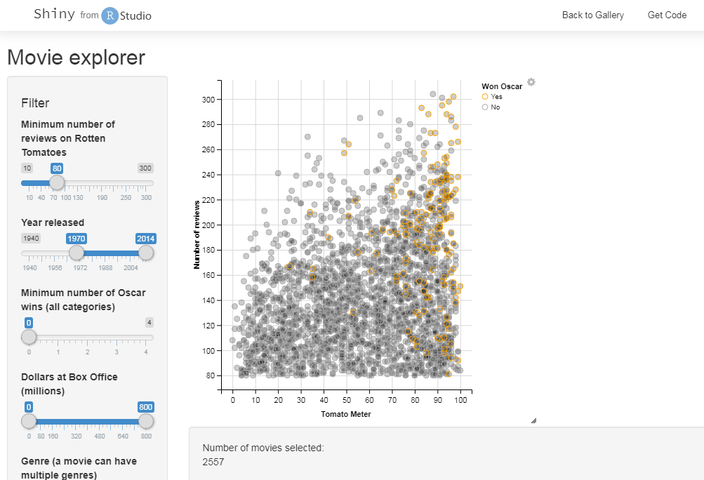
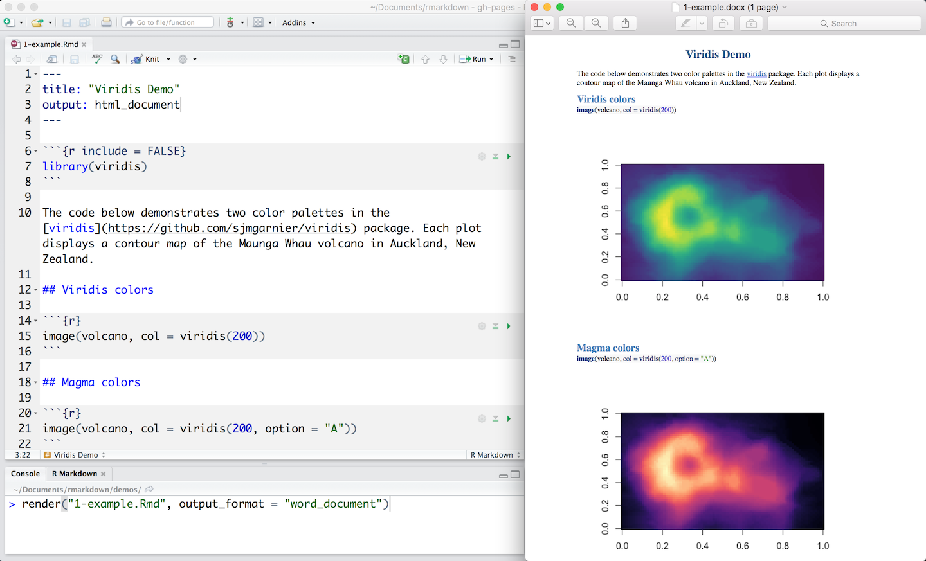
Interactive apps with Shiny:
Write your own GUI interface to run R in the background
Visualization
Twiddling with parameters
Conceptual discussion …
Reproducible documents with Quarto & Markdown
Combines running text and R code, and prints everything to Word, html, or pdf!
No seriously, this is the future.
Seriously.
Notes:
And two things that I’m going to demo….

Slide 11
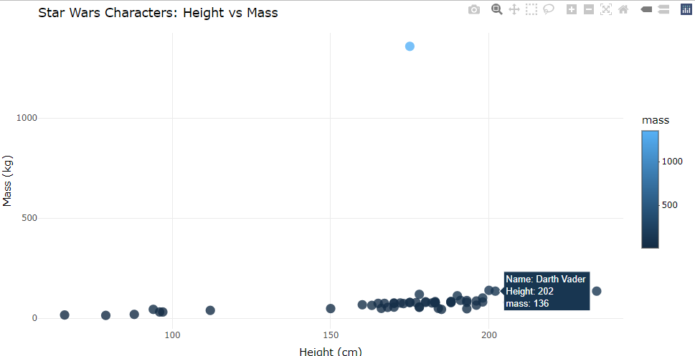
Plotly – Interactive Plots

Slide 12
Animated Plots

Slide 13
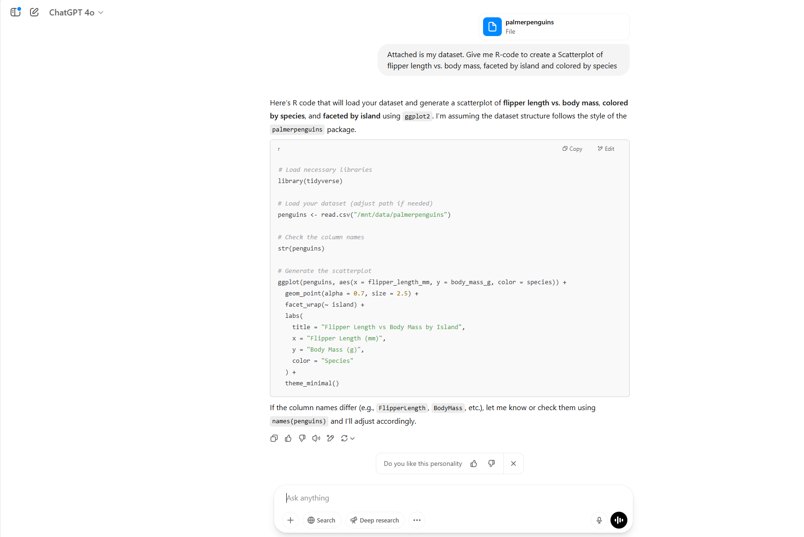
AI

